Slide 1
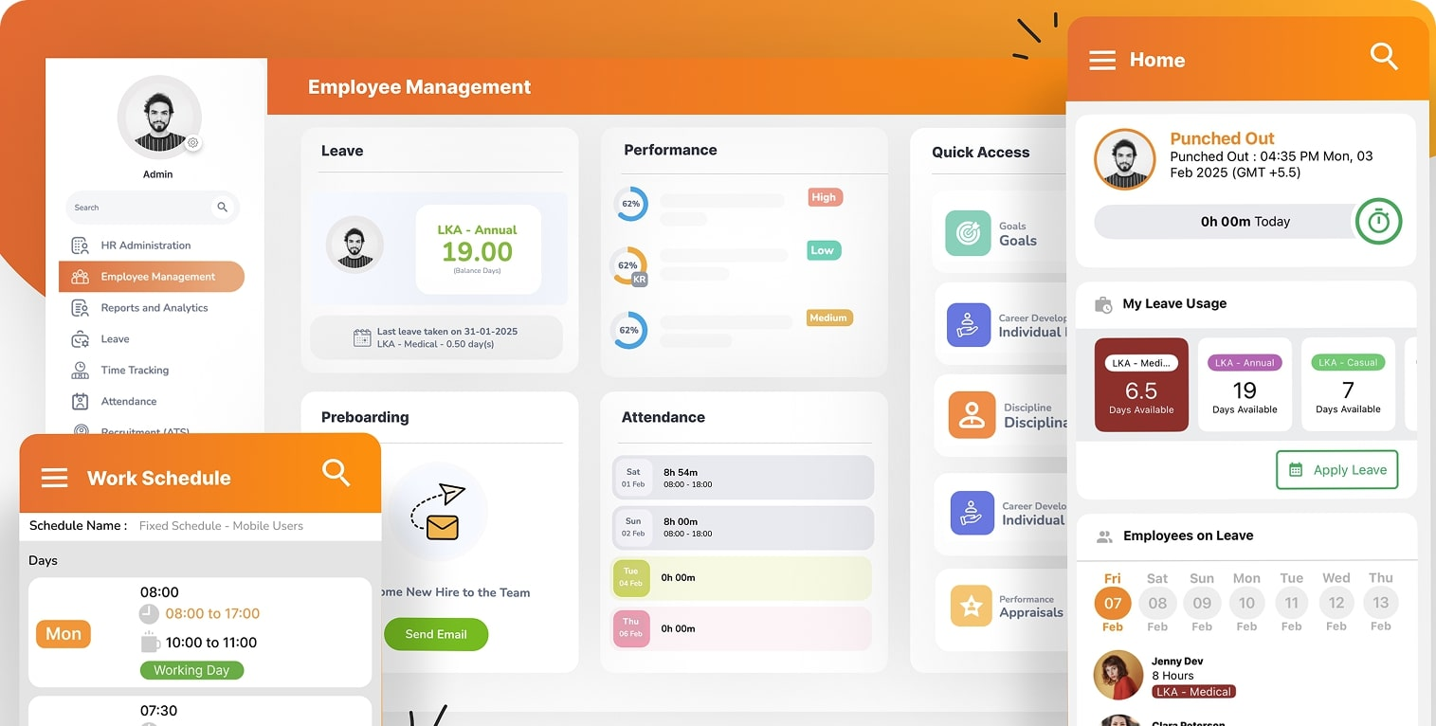
Orange
HRM
Prepared by Nagham,Haya,Abedalrahman,Mohammad

Slide 2

Introduction
The OrangeHRM is a fully functional, cloud-hosted instance of OrangeHRM's open-source HR management platform. Designed for testing and training purposes, it provides unrestricted access to all core modules including:
Employee Self-Service (ESS), Admin Tools.

Slide 3

Objective
Our Objective is to: Validate that OrangeHRM's ESS and Admin modules
meet all functional requirements .

Slide 4


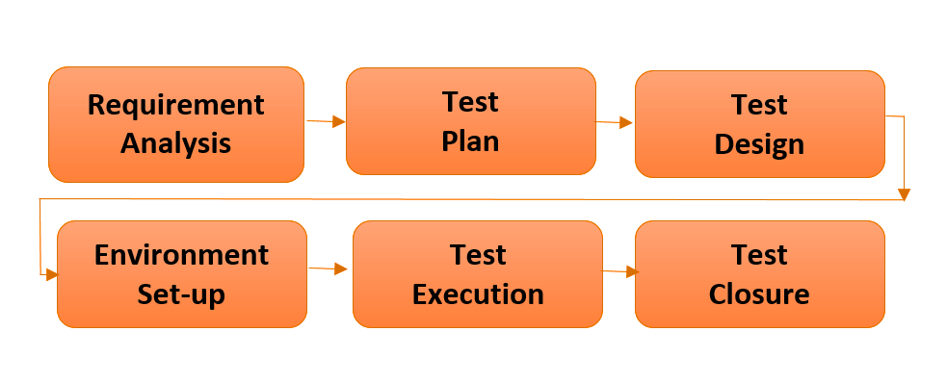
STLC

Slide 5

Requirement
Analysis
Study the SRS Document
Extract Requirements
Analyze Requirements
Make Cards for Tasks via Trello
Execute & Track Progress

Slide 6
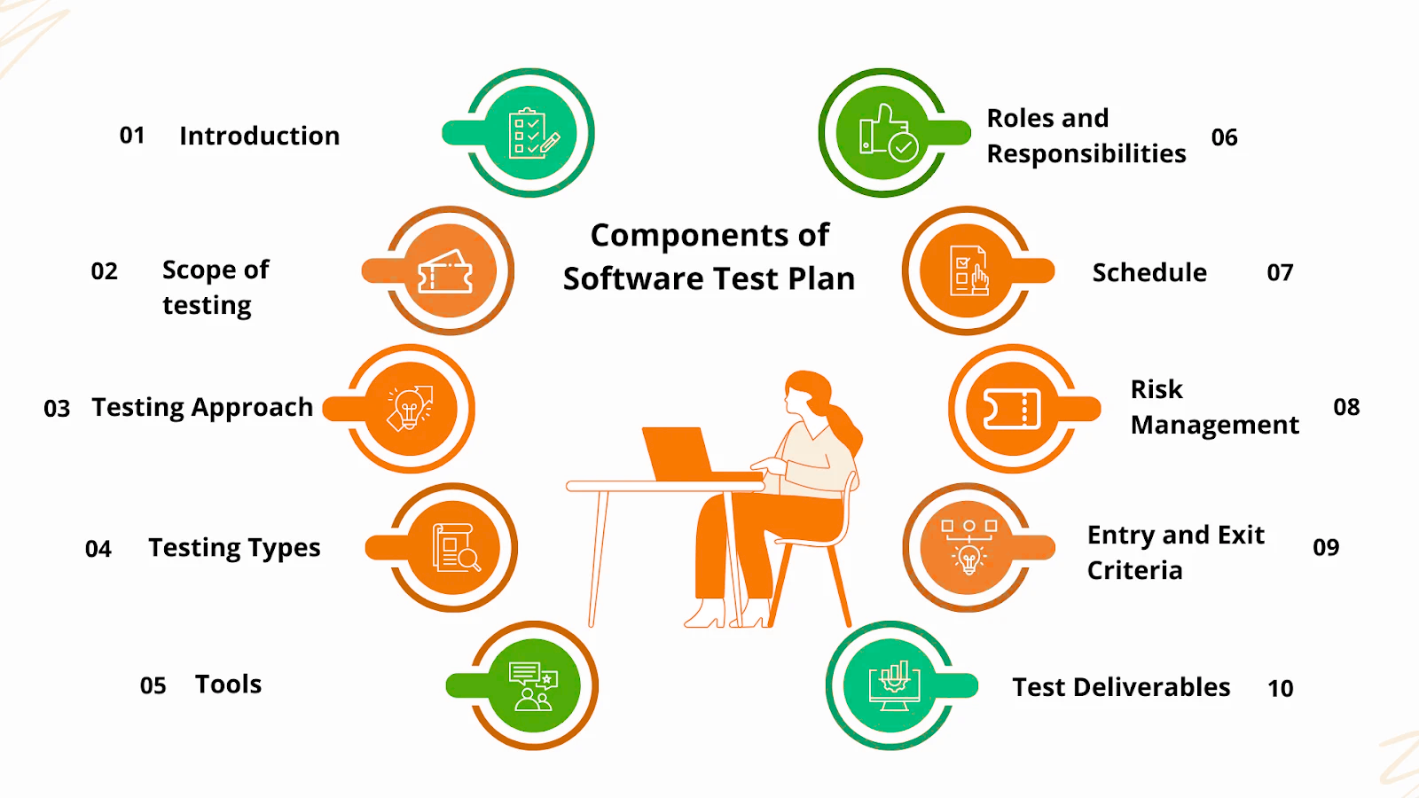
Test
Plan

Slide 7
Test
Case Design
Admin
Employee
The Test Design Covers All the required Features For Both Module

Slide 8
Test
Case Design for Employee
R1 -
Login
R2 -
My Info Module

Slide 9
Test
Case Design for Admin
R1 -
User Management Module
R3 -
Organization Module
R2 -
Job Module
R4 -
Qualifications Module

Slide 10
Test Execution
Admin
Employee
158 Tc’s
146 Tc’s
304Tc’s

Slide 11
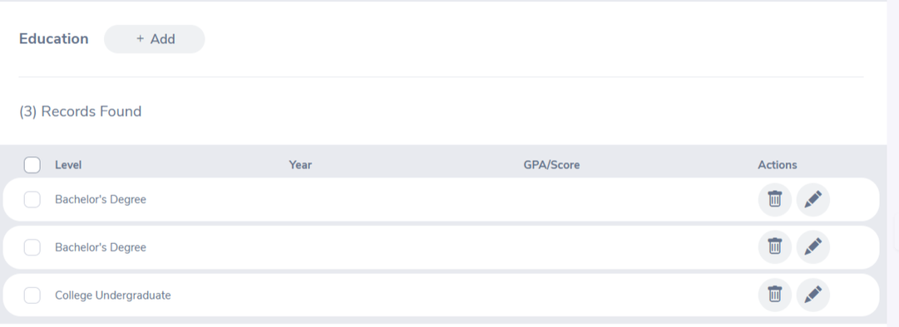
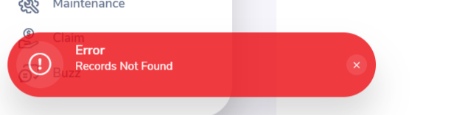
Selected
Bugs
Bug #1 . Existing education entry cannot be deleted , Error message Appears: "Entry does not exist" even though the entry exists

Slide 12
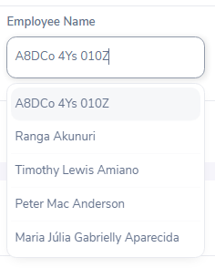
Selected
Bugs
Bug #2 . Cant create employee name when adding user, because employee name is restricted by dropdown lists (You need type for hints)

Slide 13
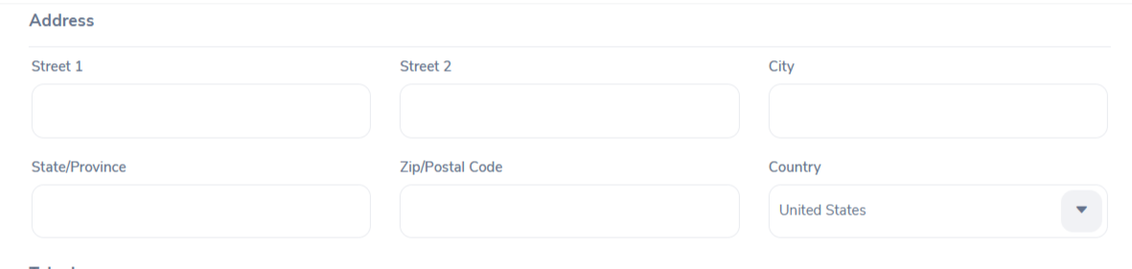
Selected
Bugs
Bug #3 . The "State" field in the Contact Details section is expected to change into a dropdown menu showing a list of U.S. states when the selected country is "United States." However, the field remains a manual text input for all countries.

Slide 14
Blocks
B#1. The user account was logged out unexpectedly and couldn’t log in again because a user with admin account had deleted the account during testing.
B#2. Working on one shared Excel file caused issues — changes didn’t sync properly, and sometimes edits were lost or overwritten.
B#3. One team member from Gaza often lost internet connection, which affected team coordination and task updates.

Slide 15
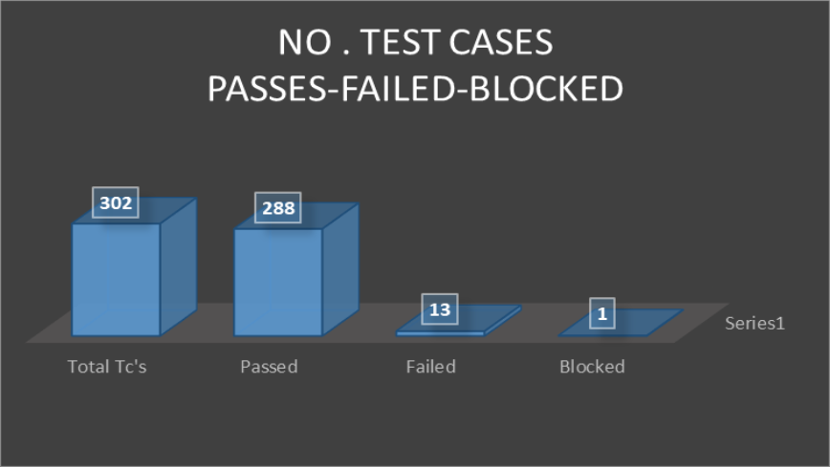
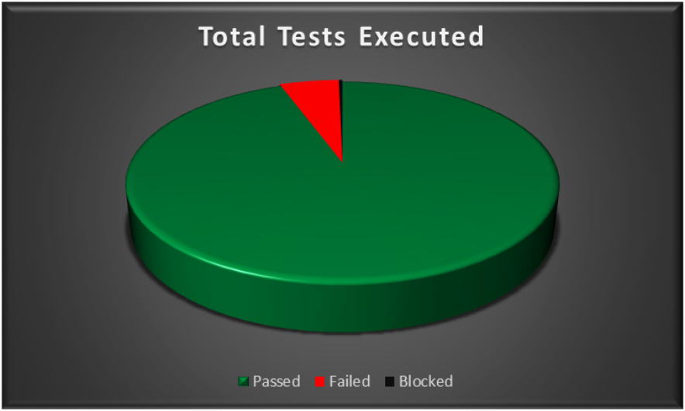
Test
Summary

Slide 16
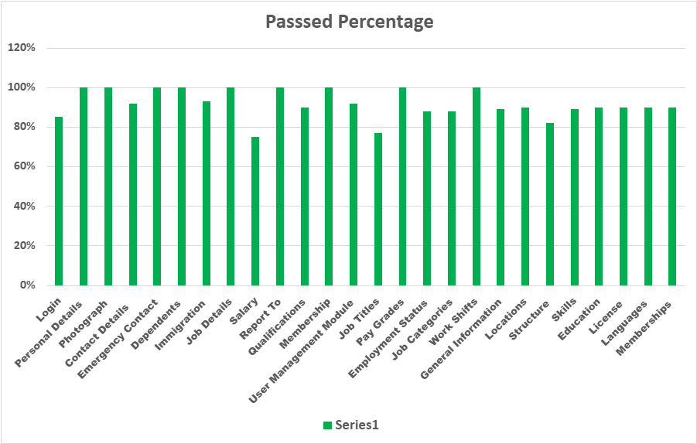
Test Cases
Passed

Slide 17
Thank you!

